Slide 1

AMCAT
By - Mohammed Mahboob

Slide 2
About me
Background – B.Tech in Mechanical Engineering with Minor in AI/ML
Why I want to learn Data Science? – I have a passion for using the data to solve real-world complex problems. Data is everything, it can solve the problem and Data Science provides a way to do so.
Linkedin - https://www.linkedin.com/in/mohammed-mahboob/
Github - https://github.com/MohammedMahboob786

Slide 3
Business Problem:
AMCAT (Aspiring Minds Computer Adaptive Test) is a computer-based test that evaluates a job applicant's skills.
The dataset contains the employment outcomes of engineering graduates as dependent variables (Salary, Job Titles, and Job Locations) along with the standardized scores from three different areas – cognitive skills, technical skills and personality skills.
Businesses/ Organization can use it to filter-out candidates and recruit high-quality talent.
Objective: The objective of AMCAT data for Exploratory Data Analysis (EDA) is to uncover insights, trends, and patterns in the employability test results to make data-driven decisions that can improve hiring processes

Slide 4
Summary of the Data:
Dependent Varaibles:
Salary
Independent Variable
Technical Skills: Scores in 'ComputerProgramming', 'ElectronicsAndSemicon', 'ComputerScience', 'MechanicalEngg', 'ElectricalEngg', 'TelecomEngg', 'CivilEngg’.
Personality Traits: Scores in 'conscientiousness', 'agreeableness', 'extraversion', 'nueroticism', 'openess_to_experience’.
Thinking Skills: Scores in 'English', 'Logical', 'Quant’
Personal Information : ID, Gender, DOB, academic records, City, Designation, Date of Joining and Date of Leaving.

Slide 5


Slide 6
Univariate Analysis: Describing a single Variable in Dataset.

Slide 7
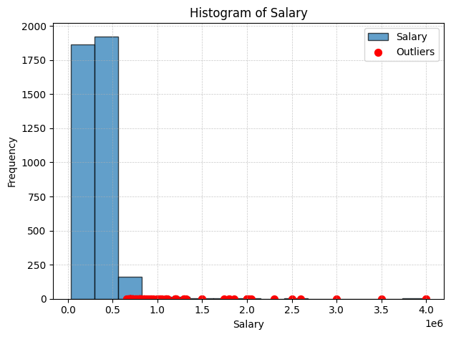
Salary
This is a Right Skewed data. Meaning most of the people gets less salary and only a few gets more salary creating outliers.
The minimum salary is 35,000 and maximum salary is 40,00,000.
The Central Value of Dataset is 3,00,000. which indicates this is the Salary most candidates get.

Slide 8
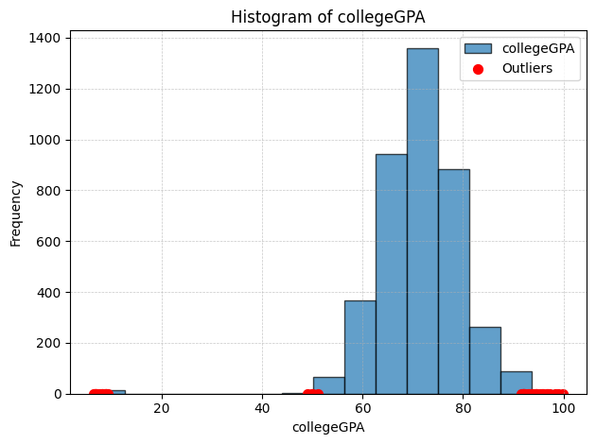
College GPA
Most of the students that attends the exam has a GPA greater than 5 and less than 9.5.
The central value of this dataset is 7.1-7.2 GPA. These are the students who generally appear for AMCAT Exam.
The outliers on the extreme left suggest that these are not outliers but Datapoints that didn’t got converted into the range of 0-100. Example : Mininimum GPA is 6.45 but it should be stored in this coulumn as 64.5.

Slide 9
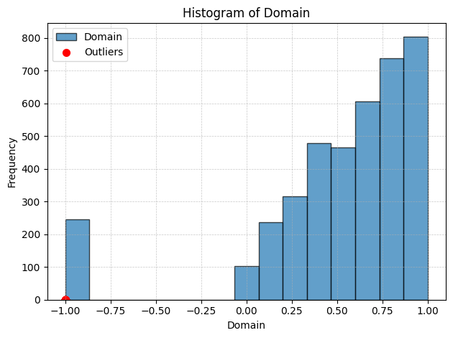
Domain
This section tells the standardized score for the tests the technical knowledge of candidates in the range of 0 to 1
It is a left skewed data which indicates most of the values are towards the Rigt side indicating many students performed really well.
The ouliers in this dataset indicates that it was a missing value in the data and was imputed to -1. and there are around 250 missing values.

Slide 10
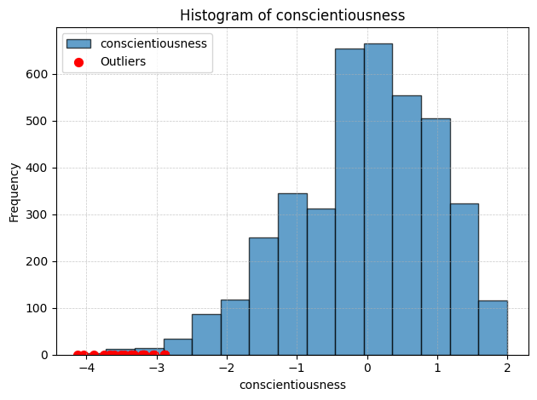
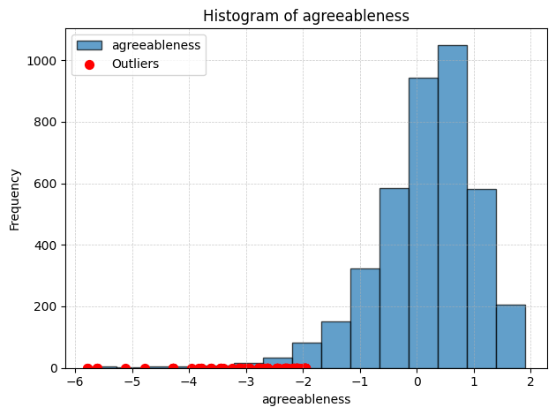
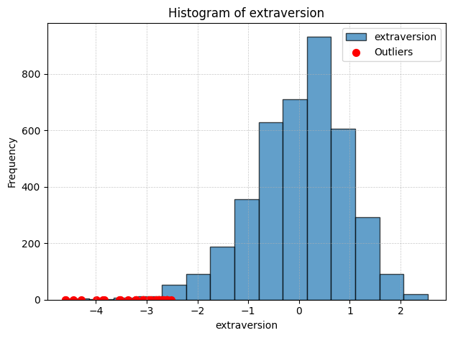
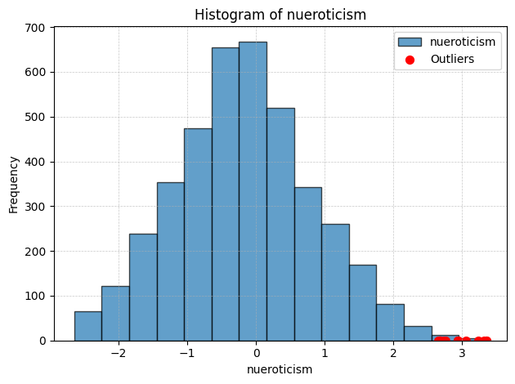
Personality Traits
Conscientiousness: This trait reflects a person’s tendency to be organized, responsible, and goal-oriented. Here the Scores are standardized and is left skewed indicating most of them are well disciplined.
Agreeableness: This trait measures a person’s tendency to be compassionate, cooperative, and trusting towards others. High agreeableness indicates a person is kind and empathetic. Here the Scores are standardized and is left skewed indicating most of them are warm and freendly.
Extraversion: Extraversion refers to the degree to which a person is outgoing, sociable, and energetic. Here the Scores are standardized and is left skewed indicating most of them are energetic and talkative.
Neuroticism: It refers to emotional stability. It reflects how prone a person is to experiencing negative emotions, such as anxiety, depression, or anger. This is Normally distributed which indicates having moderate level of neuroticism.

Slide 11
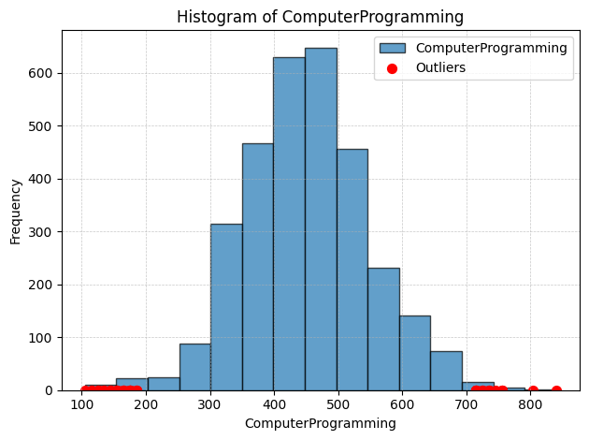
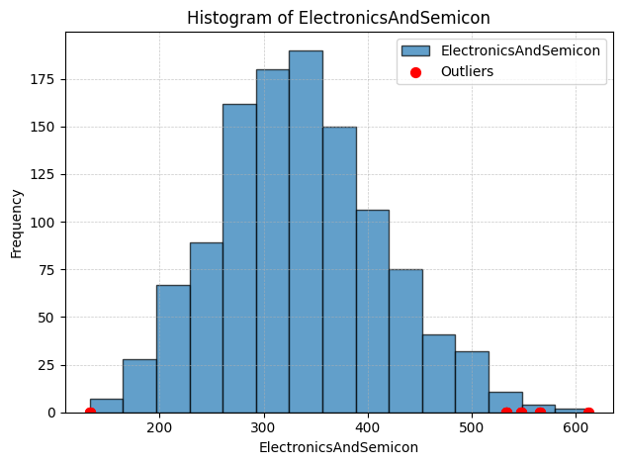
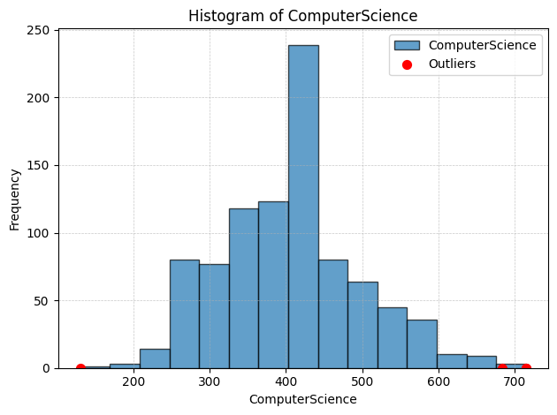
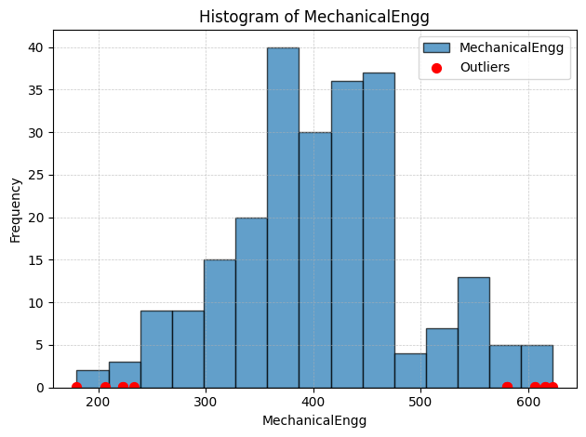
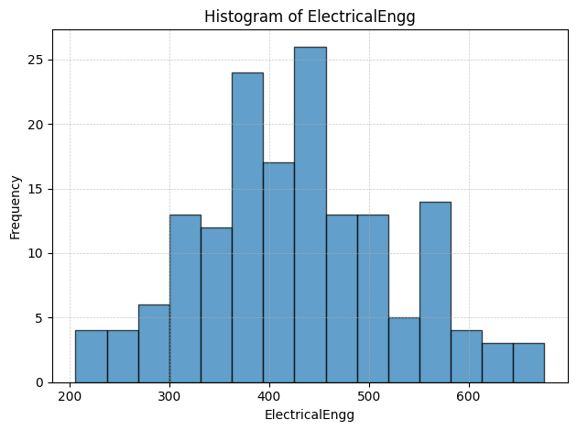
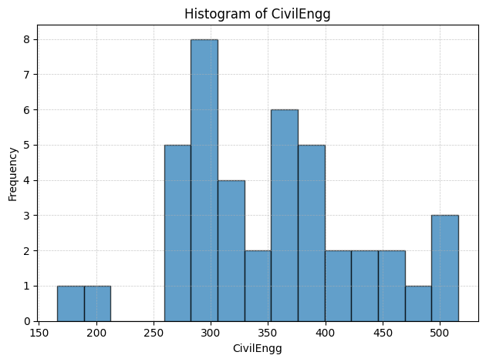
Technical Assessment
Computer Programming
78% of Candidates attended and the mean is 451.
Electronics and Semiconductor
28% of candidates attended and the mean is 335.
Computer Science
22% attended and the mean is 405.
Mechanical Engg
8.8% attended and the mean is 406.
Electrical Engg
4% attended and mean is 433.
Telecom Engg
9.3% attended and the mean is 350.
Civil Engg
0.6% attended for Civil Engg and the mean is 350.

Slide 12
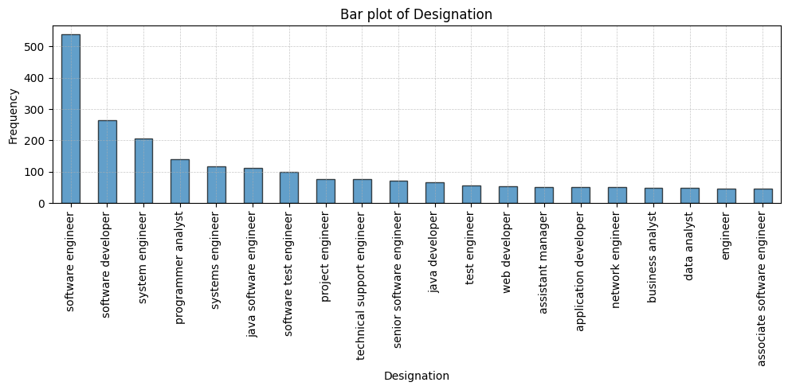
In the original Dataset there are around 400 Job roles(designation) candidates applied.
The top 20 Job roles most of the people who attended the AMCAT have applied for and the top being Software Engineer.

Slide 13
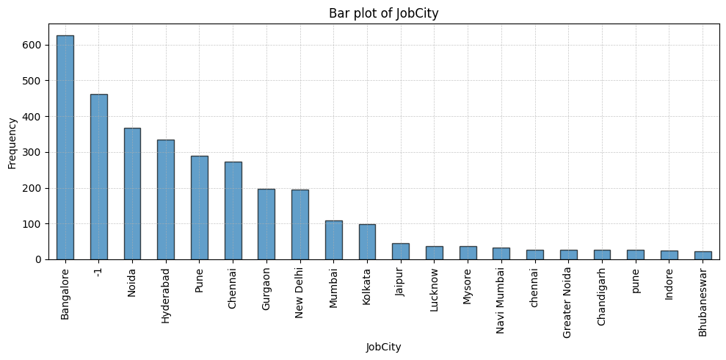
These are the top 20 cities where the candidates and currently working and the top 5 being Bangalore, Noida, Hyderabad, Pune, Chennai.
-1 indicate the missing values in the city is imputed with -1.

Slide 14
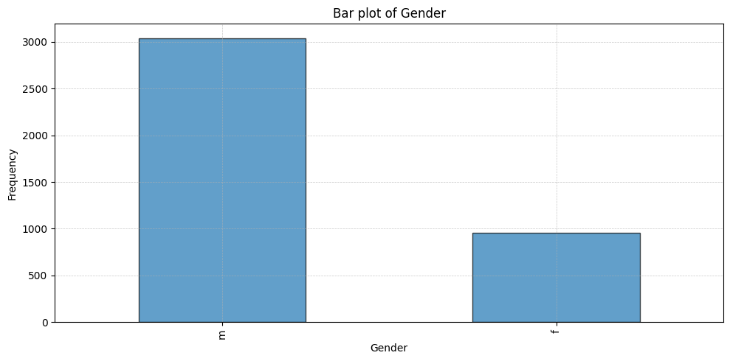
This Bar plot indicates that there are many Men (76%) who applied for AMCAT in comparison to women (23%)

Slide 15
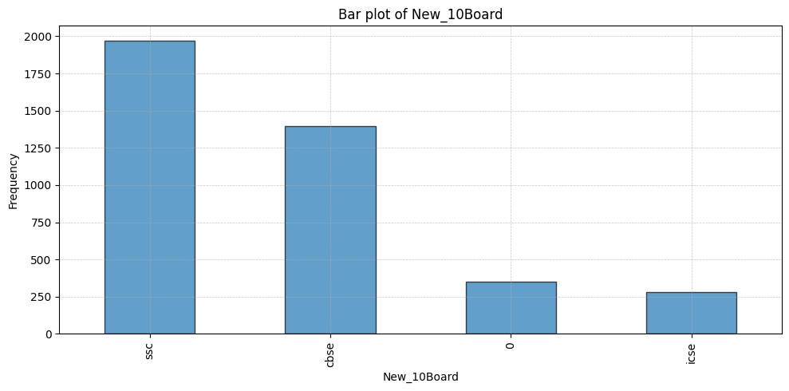
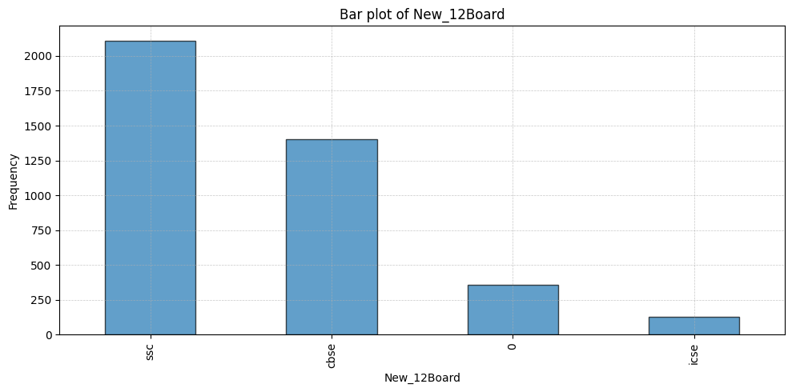
This column was not monitored properly therefore new column was created. Here it indicates most of the people who have written AMCAT belongs to SSC background.
It was also observed that many students in ICSE shifted to SSC after their 10th board.

Slide 16
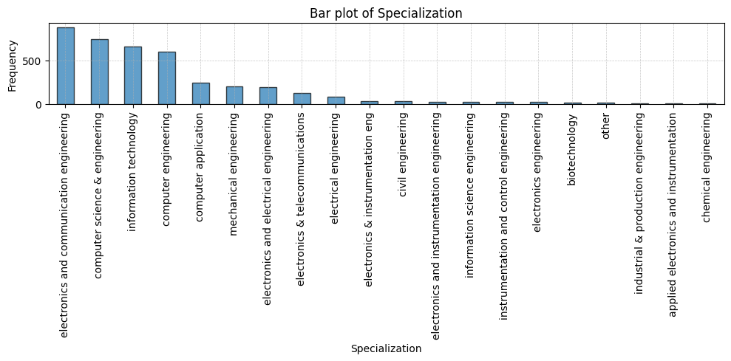
This plot indicates that most candidates have an Electronics and Communication Engineering background and are looking to transition into different fields, such as Software Engineering.

Slide 17
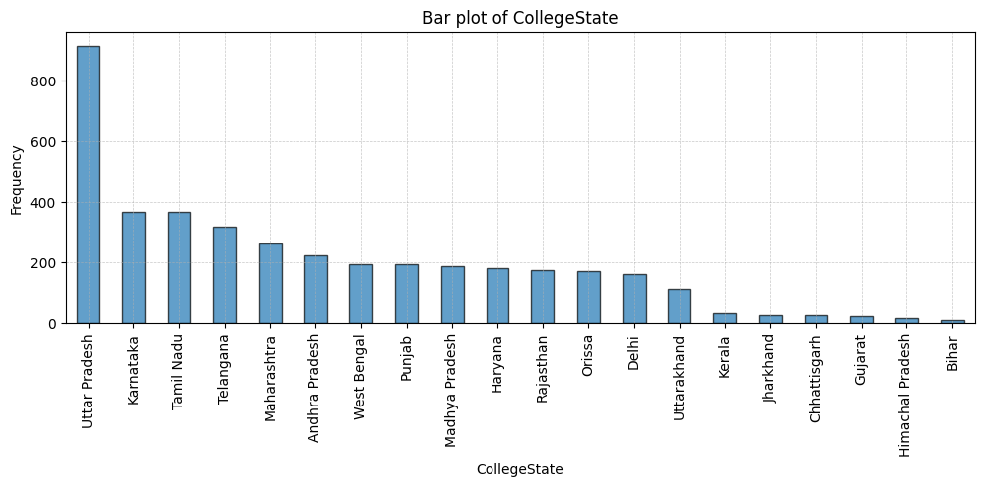
This plot indicates the state of the colleges attended by students taking the AMCAT exams. It shows that students from Uttar Pradesh are taking more AMCAT exams, suggesting a high scarcity or unavailability of jobs

Slide 18
Bivariate Analysis: Relationship B/w 2 Variables

Slide 19
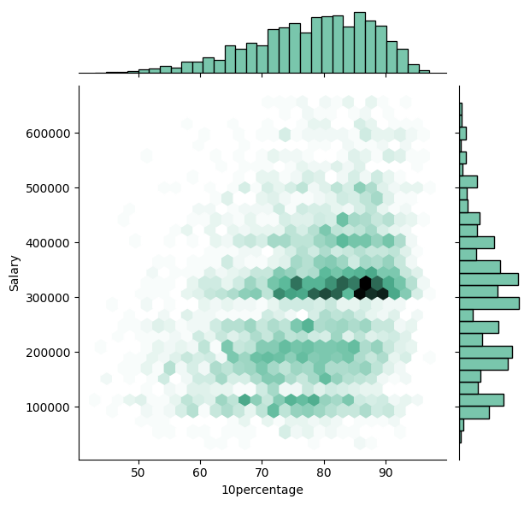
Salary vs 10 Percentage
The scatter plot continues to show a positive correlation between salary and 10 percentage, even after removing outliers. This suggests that there's a general trend of higher salaries associated with higher 10 percentages.

Slide 20
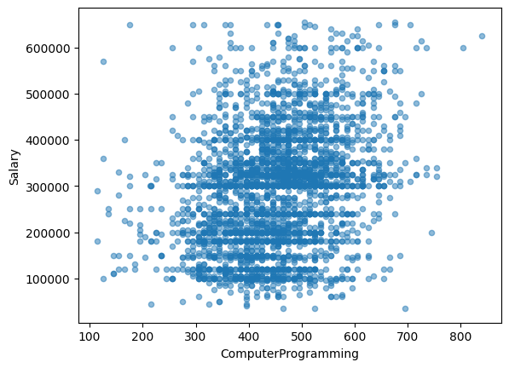
Salary vs Computer Programming
This plot suggest that the candidates who score higher generally has higher salary package. But this relationship is not too strong

Slide 21
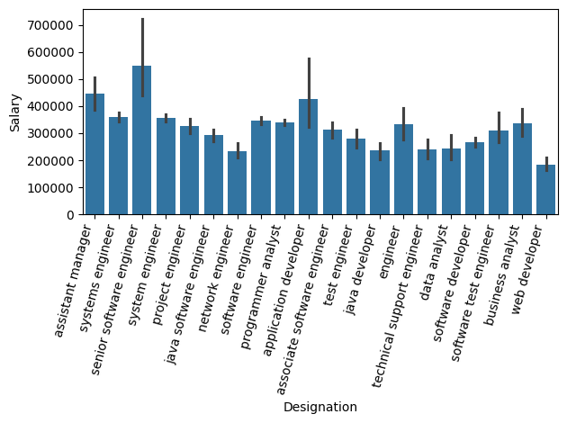
Salary vs Designation
The bar plot illustrates significant variations in salary across different job designations within the IT industry.
Software Engineer has higher salaries even with average salaries exceeding 500,000.

Slide 22
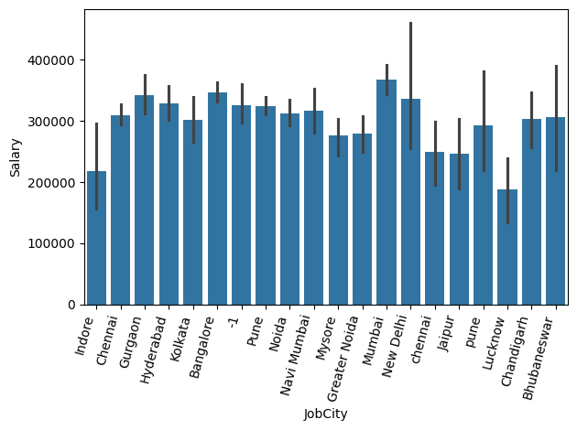
Salary vs Job City
It shows a average salary received in different city.
Mumbai shows to have higher average salary and lucknow has the lowest salry.

Slide 23
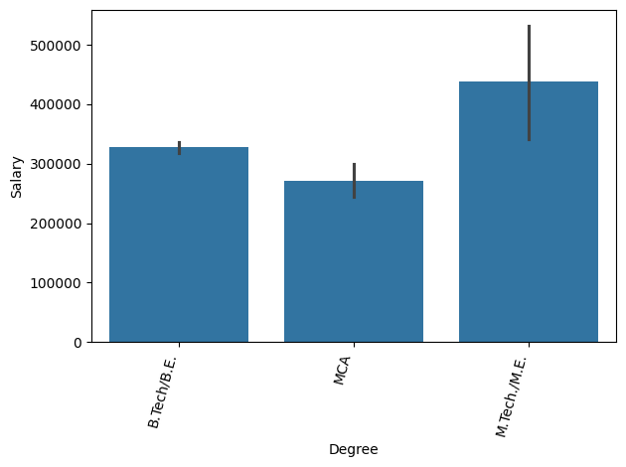
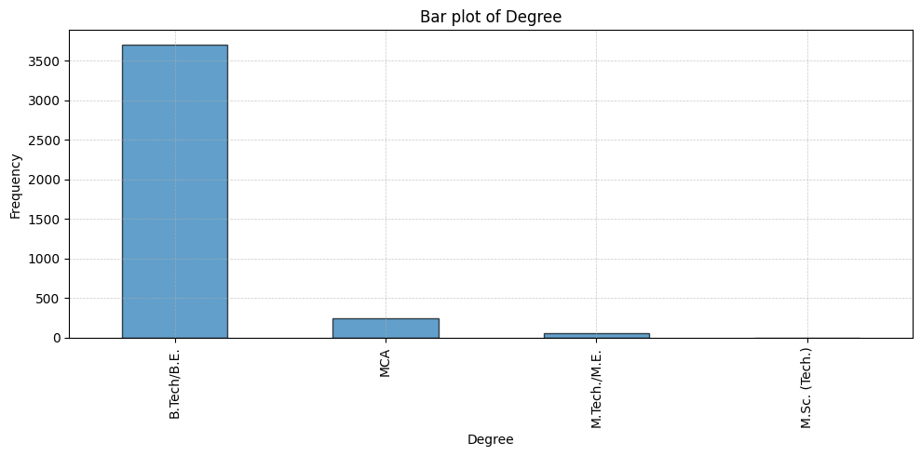
Salary vs Degree
Even though many have done B.Tech/B.E but the candidates who have done M.Tech generally receives higher salary.

Slide 24
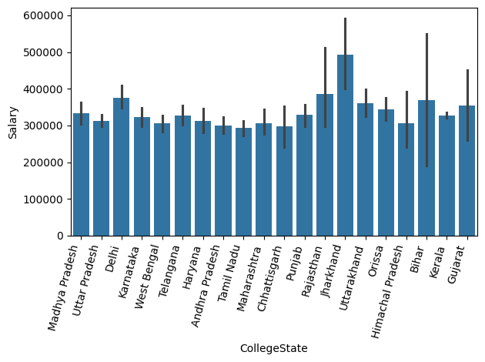
Salary vs College State
Candidates whose college is in Jharkand, Rajasthan generally tends to have higher average salary.

Slide 25
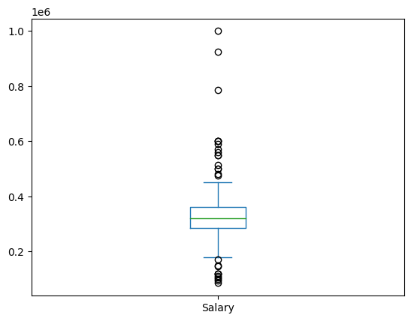
Times of India article dated Jan 18, 2019 states that “After doing your Computer Science Engineering if you take up jobs as a Programming Analyst, Software Engineer, Hardware Engineer and Associate Engineer you can earn up to 2.5-3 lakhs as a fresh graduate.” Test this claim with the data given to you.
Based on the salary data provided, the claim from the Times of India article appears to be valid for all four designations: Programming Analyst, Software Engineer, Hardware Engineer, and Associate Engineer.

Slide 26
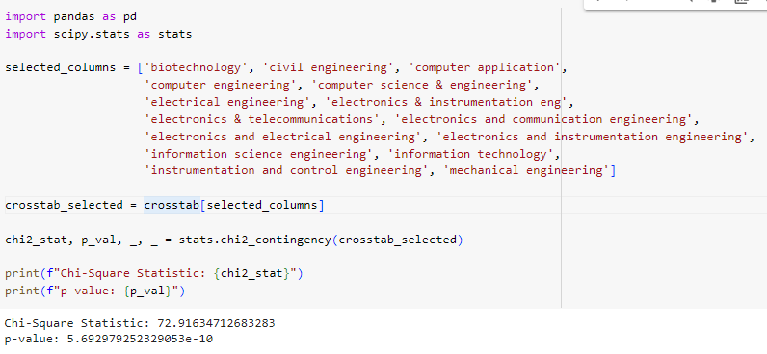
Is there a relationship between gender and specialization? (i.e. Does the preference of Specialisation depend on the Gender?
After performing chi square test of independence. The p-value which is very small indicates that the preference of Specialisation depends on the Gender.

Slide 27
Conclusion
The EDA of the AMCAT dataset highlights that a majority of candidates come from engineering backgrounds, particularly Electronics and Communication Engineering. Salary analysis reveals outliers that indicate discrepancies in expected compensation. The geographical representation shows higher participation from states like Uttar Pradesh, suggesting a link between location and job scarcity. It was also noticed that M.Tech students are higly paid compared to B.Tech. Students Whose college is in Jharkhand has higher salary. Software engineer tends to have higher pay.

Slide 28

THANK YOU

